Slide 1
Netflix Analysis: Duration vs. Release Year
Examining whether newer Netflix titles tend to be shorter
1 / 10
Notes:
This presentation focuses only on the relationship between release year and duration, as requested. We separated movies and TV shows because duration is measured differently for each type.

Slide 2
Dataset Scope
8,807
6,131 movies and 2,676 TV shows were included
Release year and duration were the key variables analyzed
Netflix titles analyzed
2 / 10
Notes:
The dataset contains 8,807 Netflix titles in total. This gives us enough observations to explore broad patterns, while still keeping the analysis focused on the specific question of duration versus release year.

Slide 3
Research Focus
Question: Does release year relate to title duration?
Movies: Duration measured in minutes
TV shows: Duration measured in number of seasons
Goal: Identify whether newer titles differ in length
3 / 10
Notes:
The main objective was not to describe the full Netflix catalog, but to test one relationship only: whether release year is associated with how long a title is. Because movies and TV shows use different duration measures, they were analyzed separately.

Slide 4
Analysis Approach
1
Prepare Variables
Use release year and duration fields
2
Separate Content Types
Analyze movies and TV shows independently
3
Visualize Relationship
Plot duration against release year
4
Interpret Results
Assess pattern strength and practical meaning
→
→
→
4 / 10
Notes:
This slide explains the analytical flow. First, the relevant variables were prepared. Then the dataset was split by content type, visualized, and interpreted to understand whether any trend existed between release year and duration.

Slide 5
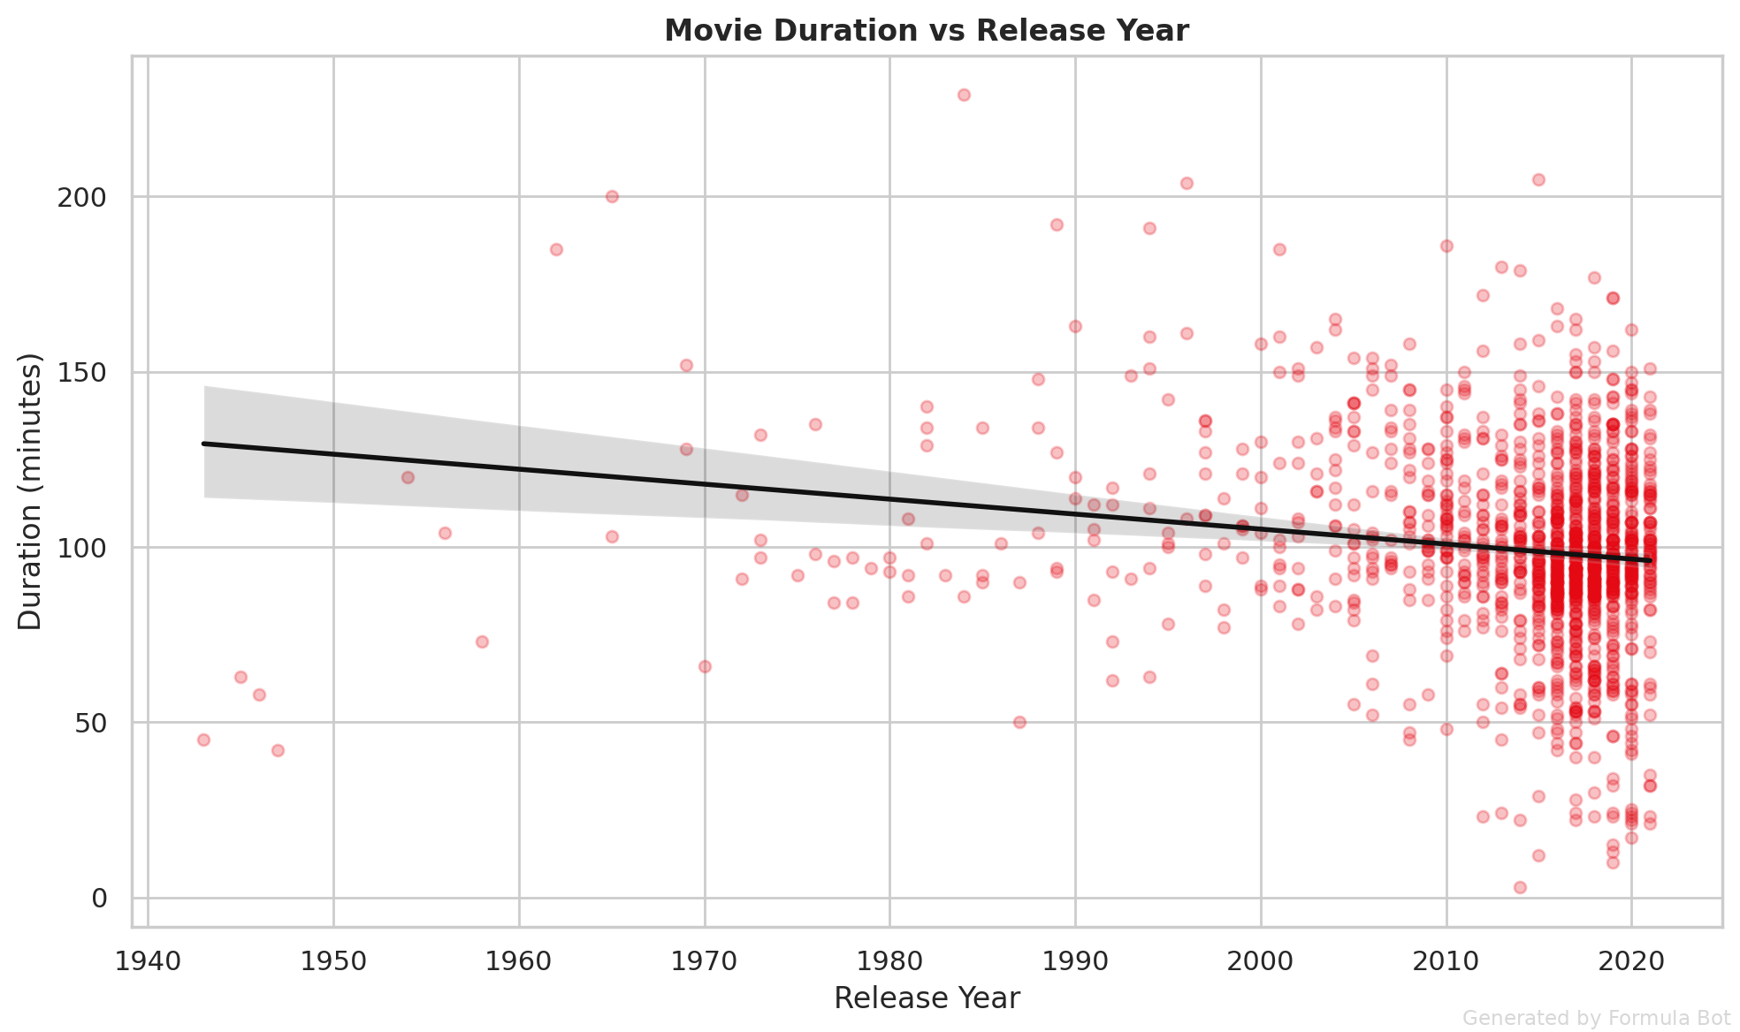
Movie Duration vs. Release Year
Weak negative relationship appears across movie releases
Newer movies are slightly shorter on average
Source: Netflix titles dataset analysis
5 / 10
Notes:
This chart shows the movie side of the analysis. The trend is negative, but only weakly so. That means release year may have some association with runtime, yet the effect is not large enough to suggest a strong structural shift.

Slide 6
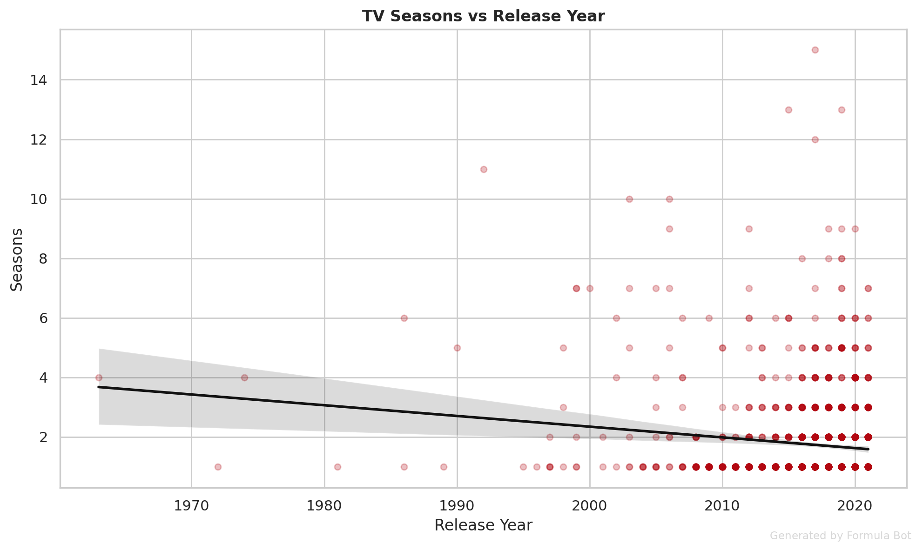
TV Show Seasons vs. Release Year
Very small relationship appears between release year and seasons
Pattern is weak in practical terms
Source: Netflix titles dataset analysis
6 / 10
Notes:
For TV shows, the relationship is even weaker than for movies. The number of seasons does not change much in a clear way across release years, so release year alone is not a useful predictor of TV show length.

Slide 7
Movies vs. TV Shows
Movies
TV Shows
Duration measured in minutes
Weak negative trend over release years
Newer films are slightly shorter
Duration measured in seasons
Very small relationship over release years
No strong pattern in practice
7 / 10
Notes:
Comparing both analyses side by side helps clarify the overall finding. Movies show a slight directional trend, while TV shows show almost none. This suggests the relationship depends on content type and remains limited overall.

Slide 8
“
Newer movies are slightly shorter on average, while TV shows show almost no meaningful pattern by release year.
8 / 10
Notes:
This is the single takeaway to emphasize during the presentation. The relationship exists more clearly for movies than for TV shows, but even then it remains weak rather than dramatic.

Slide 9
Potential Issues and Limitations
Catalog data reflects Netflix listings only
Duration format differs across movies and TV shows
Release year alone cannot explain content length
Weak relationships require cautious interpretation
9 / 10
Notes:
These limits are important to mention to the doctor. The dataset captures Netflix titles, not all entertainment releases. Also, duration is fundamentally different for films and series, which is why we avoided combining them into one measure.

Slide 10
Key Takeaways
8,807 titles formed the analysis sample
Movies show a weak negative duration trend over time
TV shows show only a very small relationship
Conclusion: Release year has limited practical influence on duration
10 / 10
Notes:
To close, the analysis supports a careful conclusion rather than a dramatic claim. Release year has some limited association with movie runtime, but very little connection with TV show seasons. Overall, duration is influenced by more than release timing alone.

